Slide 1
UHV-I
Session 7
Ensuring Health Holistically
Making a definite program for health

Slide 2


Slide 3
Interaction Before Main Session
Hear from participants about their exploration from previous day(s)
Q&A
Place some expected conclusions, find out if they also came to these/similar conclusions

Slide 4
Home Assignment
6.1. Take your list of concerns at individual level
For each concern, find out the preconditioning or sensation that is behind that concern
Then find out what you need to understand to resolve your concerns
As we cover more content, keep exploring the possible resolution of each concern
Notes:
We will explore if this provides a resolution for that concern

Slide 5
UHV-I
Session 7
Ensuring Health Holistically
Making a definite program for health

Slide 6
Fulfilling our Aspiration for Health
We all aspire to stay healthy and are concerned about being ill
When we understand human being comprehensively, we have the feeling of responsibility towards the body, we are able to make out the right program to keep the body in harmony… and stay healthy
Let us explore this

Slide 7
Recalling…
Human Being Ekkuo | Self (I) eSa | Body “kjhj
Need vko';drk | Happiness (e.g. Respect) lq[k ¼tSls lEeku½ | Physical Facility (e.g. Food) lqfo/kk ¼tSls Hkkstu½
In Time dky esa | Continuous fujUrj | Temporary lkef;d
In Quantity ek=k esa | Qualitative (is Feeling) xq.kkRed ¼Hkko gS½ | Quantitative (Required in Limited Quantity) Ekk=kRed ¼lhfer ek=k esa½
Fulfilled By iwfrZ ds fy, | Right Understanding & Right Feeling lgh le>] lgh Hkko | Physio-chemical Things HkkSfrd&jklk;fud oLrq
Co-existence
lgvfLrRo
Notes:
Who is the observer? Self or body?
Can you see that you are always active “imagination” is always going on

Slide 8

Further, we can see…
Co-existence
lgvfLrRo
Human Being Ekkuo | Self (I) eSa | Body “kjhj
Need vko';drk | Happiness (e.g. Respect) lq[k ¼tSls lEeku½ | Physical Facility (e.g. Food) lqfo/kk ¼tSls Hkkstu½
Fulfilled By iwfrZ ds fy, | Right Understanding & Right Feeling lgh le>] lgh Hkko | Physio-chemical Things HkkSfrd&jklk;fud oLrq
 | Feeling of Self-regulation (संयम)
 | Feeling of responsibility toward the body – for Nurturing, Protection and Right Utilization of the Body
Notes:
Who is the observer? Self or body?
Can you see that you are always active “imagination” is always going on

Slide 9
Further, we can see…
Co-existence
lgvfLrRo
Human Being Ekkuo | Self (I) eSa | Body “kjhj
Need vko';drk | Happiness (e.g. Respect) lq[k ¼tSls lEeku½ | Physical Facility (e.g. Food) lqfo/kk ¼tSls Hkkstu½
Fulfilled By iwfrZ ds fy, | Right Understanding & Right Feeling lgh le>] lgh Hkko | Physio-chemical Things HkkSfrd&jklk;fud oLrq
 | Feeling of Self-regulation (संयम) | Health (स्वास्थ्य)
 | Feeling of responsibility toward the body – for Nurturing, Protection and Right Utilization of the Body | The Body acts according to the Self Parts of the body are in harmony (in order)
With a feeling of self-regulation, health of a sick body can be restored
Without the feeling of self-regulation, even a healthy body can become unhealthy
Check: how many times you fell sick in the past one month, and what was the reason?
Notes:
Who is the observer? Self or body?
Can you see that you are always active “imagination” is always going on

Slide 10
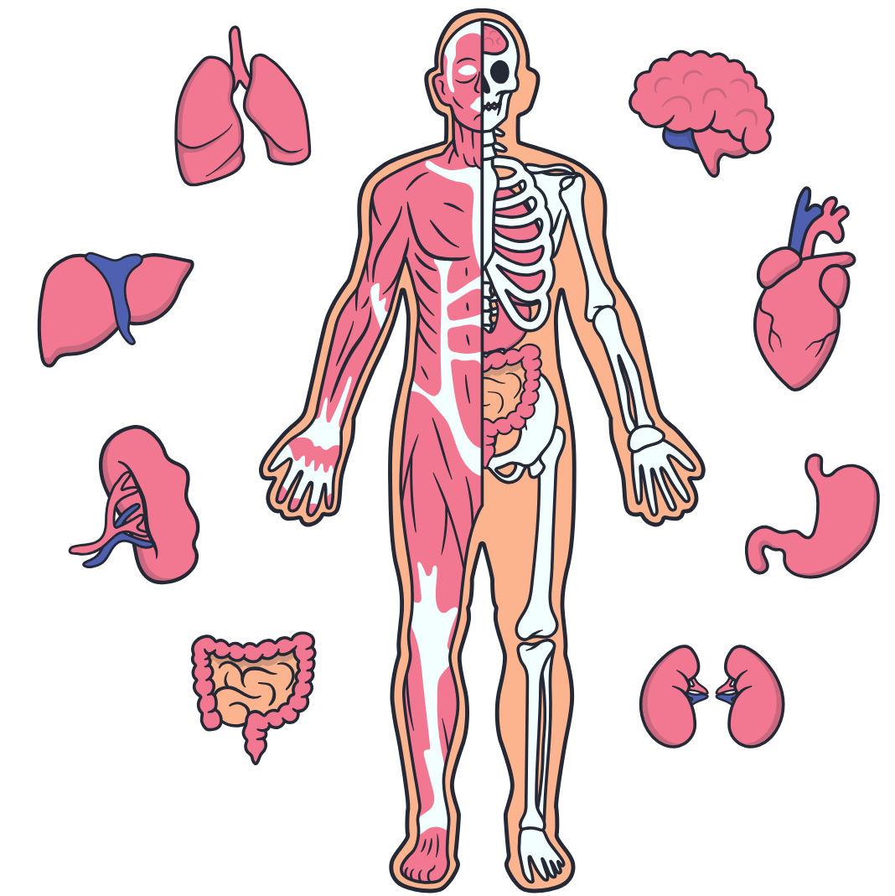
Feeling of Self-regulation (संयम) → Program for it → Health in the Body
The Body is an orderly system (a harmony). It is composed of trillions of cells – these are working in a complimentary manner (forming tissues, organs, organ systems …), all for the harmony of the body!
All I (Self) have to ensure is the continuity of that harmony
(at least not disturb it).
With the feeling of responsibility toward the body,
I do what is required for fulfilling that responsibility.
This ensures the health in the Body.
We will explore a program to ensure health …..
Out of self-regulation and health, which holds the higher priority for you?

Slide 11
Program for Health
(A) For Staying Healthy
  1 Intake and Routine (Lifestyle)
  2 Labour and Exercise
  3 Postures for regulating internal & external body organs
  and Regulated Breathing
(B) For bringing body back to harmony from temporary disharmony
(C) Dependence on drug / machine to perform a body function
4a Medicine
4b Treatment
1a. Intake includes air, water, sunlight, food (food is nutritious, digestible & tasty and waste is excretable), all intake through our senses (sound, sight, smell etc)
1b. Rising time, sleeping time, eating time…
2a. Outcome of labour is production of physical facility
2b. No physical facility is produced by exercise

Slide 12
Intake (आहार)
Intake includes all that we take in through our sense organs – air, water, sunlight, food…
Along with this, we also have feelings and thoughts in response to outside events/circumstances etc.
To maintain health:
  Intake of food that is not only tasty but also nutritious and digestible and rich in fibre (making its waste easily and efficiently excretable)
  Intake of water in the right amount and at the right time
  Daily exposure to fresh air and sunlight
  Awareness of choice of food as above and how much to eat (sensation of fullness)
  Avoiding distractions by other intake through our senses and the thoughts they generate in us, especially while eating.
  e.g. what we are seeing (focusing on the meal or watching TV, playing games on the mobile etc) and hearing/being a part of (?arguments with others),

Slide 13
1b. Routine – in Harmony with Nature
Our routine has an impact on the health of the body
(daily routine, seasonal routine and other life-cycle routines)
Check if it matters what time
You sleep
You get up
What time you cleanse the body
What time you study
Eating time
Etc.
Routine in synchronization with nature help in maintaining health
e.g., a daily routine which is in line with the day-night cycle
(Check out “circadian rhythm”)

Slide 14
Labour श्रम
Exercise व्यायाम
Ensure adequate movement of the Body + production of physical facility
Examples:
  Participating in household chores
  Production activities
  Sweeping and swabbing your room / house / hostel
  Kitchen gardening
  Cycling to your college and back…
Ensure adequate movement of the Body
(to compensate for the lack of labour)
Examples:
  Walking, jogging, running
  Swimming
  Physical exercises…

Slide 15
Postures, Breathing
Postures for regulating internal and external body organs
Regulated Breathing
Examples:
  Yoga (योग)
  Resonant breathing
  Pranayam (प्राणायाम)

Slide 16
Medicine
Treatment
For bringing body back to harmony from temporary disharmony
Examples:
  Home remedies
  Integrated systems of medicine
Using a drug / machine to perform a body function (dependence)
Examples:
  Insulin
  Dialysis

Slide 17
Priority
1
(A) For Staying Healthy
  1 Intake and Routine (Lifestyle)
  2 Labour and Exercise
  3 Postures for regulating internal & external body organs
  and Regulated Breathing
  4a Medicine and 4b Treatment
1a
1b
2
(B) For bringing body back to harmony from temporary disharmony
3
(C) Dependence on drug / machine to perform a body function

Slide 18
Holistic Perspective of Health
Mental health or health of the Self
    Understanding the human being
    Understanding the Self
      → harmony in the Self Healthy Self
Physical health or health of the body
    Understanding the body
      → harmony in the body Healthy Body
Conditions for mental and physical health
i.e. health of the environment
    Understanding the environment
      → harmony in the family
      → harmony in the society Healthy Environment
      → harmony in the nature/existence
1
2
3

Slide 19
Discussion: Health of the Family, Friends…
Discussion: Health of the Society (Institution…)
Food habits
Daily routine
Seasonal routine
Collective labour
Collective exercise
Home remedies…
Hostel – Timings for healthy lifestyle (sleeping time, waking time…)
Mess – Options for tasty and healthy food…
Canteen – Tasty and healthy options
Juice stall – fresh fruit and vegetable juice
…

Slide 20
Home Assignment

Slide 21
Home Assignment
7.1. Are you able to see that a feeling of responsibility toward the body is required for your health to be ensured?
    Share 3 instances from your life where your body became unwell due to lack of attention to the feeling of responsibility towards your body
7.2. Reflect on the program for health. Are you able to see the significance of the intake and daily routine?
    Share 2 instances from your life where you could have avoided getting sick by taking the right kind of food
    Share 2 instances from your life where you became unwell because your routine was upset
7.3. Is the topic of staying healthy necessary to be included in your education, in campus life?
      Suggest in what form it can be included in education by teachers, management… (counselling, courses, etc.)
      Suggest ways and means it can be implemented by you, other students, wardens… in campus life (in the student clubs, hostel, mess, canteen, health centre, etc.)

Slide 22
Questions?

Slide 23
Discussion: Health of the Natural Environment
Clean and fresh air
Water
Free of viruses
…
Natural Farming Club – In campus production by way of labour

Slide 24
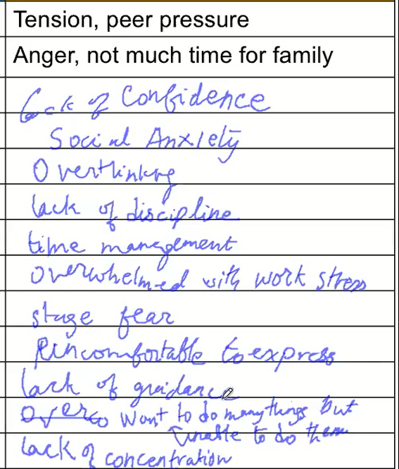
Concerns at individual level
What is to Be Understood to Resolve this Concern
Human being, relationionship

Slide 25
Aspirations and Concerns at the Individual Level
To be happy
To be healthy
Knowledge – quest for knowledge
Ability to decide properly on my own, independently
Purification of the mind
Controlling the mind
Self confidence
Coming out of stress
Managing pressure of academics
Time management
Loss of time due to illness
Entertainment
Domination of one gender by the other
Pressure of placement
Overcoming –ve thinking
Attending classes
Peer pressure
Temptations
Anger
Depression
Suicidal thoughts

Slide 26
Aspirations
Concerns
To be healthy
Want to eat tasty but healthy food
Want a healthy, peaceful environment
Infections (environment)
Non-communicable disorders like obesity
Tension, depression
Inefficient use of time
Time loss due to illnesses
Let us explore how understanding human being can help us in:
realising our aspirations and also resolving the concerns holistically

